Slide 1
C# Professional Level 1
C# Basics

Slide 2
Chapter Agenda
01
02
03
04
05
Basic syntax
System Types
Numeric Types
Text
DateTime
Value Types
Reference Types
Conditional logic
Visibility
Class
Struct
Execution flow

Slide 3
Basic Syntax

Slide 4
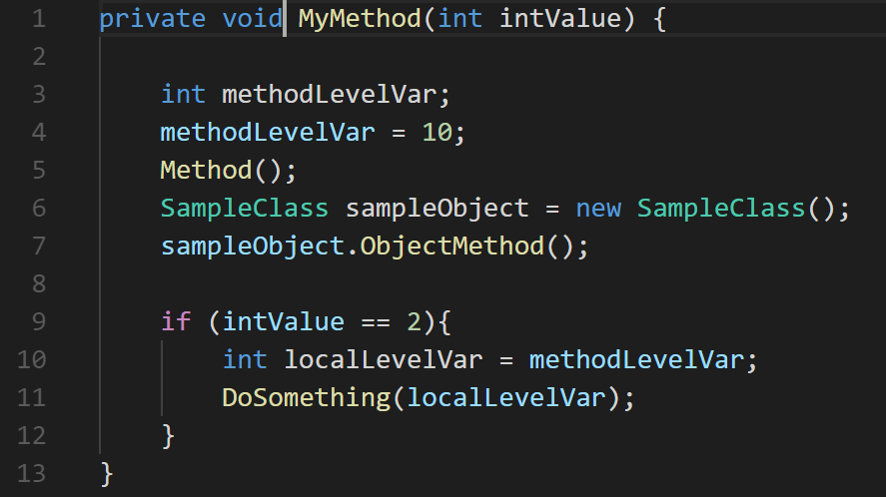
Basic Syntax
Sample
Notes:
Variable declaration, assignation
Instance method calling
Object instance creation, member func
Executing if statement
Talk about method scope

Slide 5
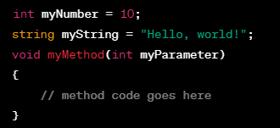
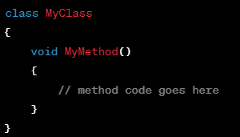
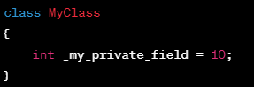
Basic Syntax
Name coding typology
camelCase
PascalCase
Snake_case
Notes:
Naming conventions / Coding guidelines

Slide 6
Basic Syntax
Guidelines (make your code easier to read)
DO | be consistent when defining a naming convention
DO | try to match classic rules
DO | use productivity tools like R#, Roslyn Analyzer to help developers
DO | use tools like Stylecop to check the code
DON’T | Don’t write a documentation on naming convention if you do not have any tools to check they are properly applied.
Notes:
It's important to note that while this is the convention in C#, it's not a hard and fast rule. Ultimately, the most important thing is consistency within your own codebase or project, or adhering to the style guidelines of the team or organization you're working with.

Slide 7
Namespaces
How to organize your types

Slide 8
What is « namespaces »
In C#, a namespace is like a container that holds related code together. It helps you organize your code and prevent naming conflicts.
Think of it like a set of drawers in a cabinet.
Each drawer holds different items, but they're all related in some way.
Similarly, each namespace holds different classes, but they're all related to a particular area of functionality in your application.
Notes:
For example, let's say you're building a program that involves both math and science calculations. You might want to organize your code into two different namespaces, one for math-related code and one for science-related code. This would help you keep everything organized and prevent naming conflicts between classes that might have the same name but serve different purposes.

Slide 9
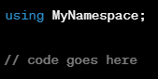

How use it
To use a namespace in your code, you simply include a using statement at the top of your file, like this:
This tells the compiler that you want to use the classes in the MyNamespace namespace. Then you can reference the classes within that namespace in your code, like this:
Here, MyClass is a class within the MyNamespace namespace, so we use the namespace name followed by the class name to create a new object of that class.
Notes:
Live demo of using

Slide 10
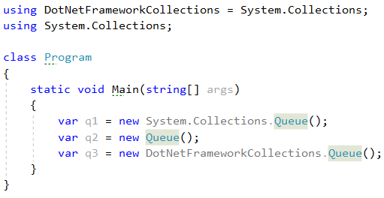
Overview
Organize and structure your types
Hierarchical: level separated by a « . »: System.Net.IO
Use the keyword « using » to avoid to name a type with the whole namespace part.
Written in pascal case
« global » namespace is the root namespace. Useful when there is ambiguity: global::System
You can also create alias some to remove ambiguity

Slide 11
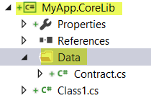
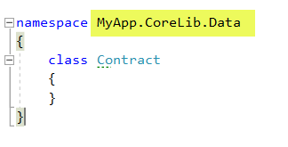
Guidelines
DO | match the root namespace of your project with the Assembly Name
DO | match the namespace of each source file with the Assembly Name of your project, including the directory hierarchy
DON’T | use the same namespace in different project

Slide 12
System Types
Numeric Types

Slide 13
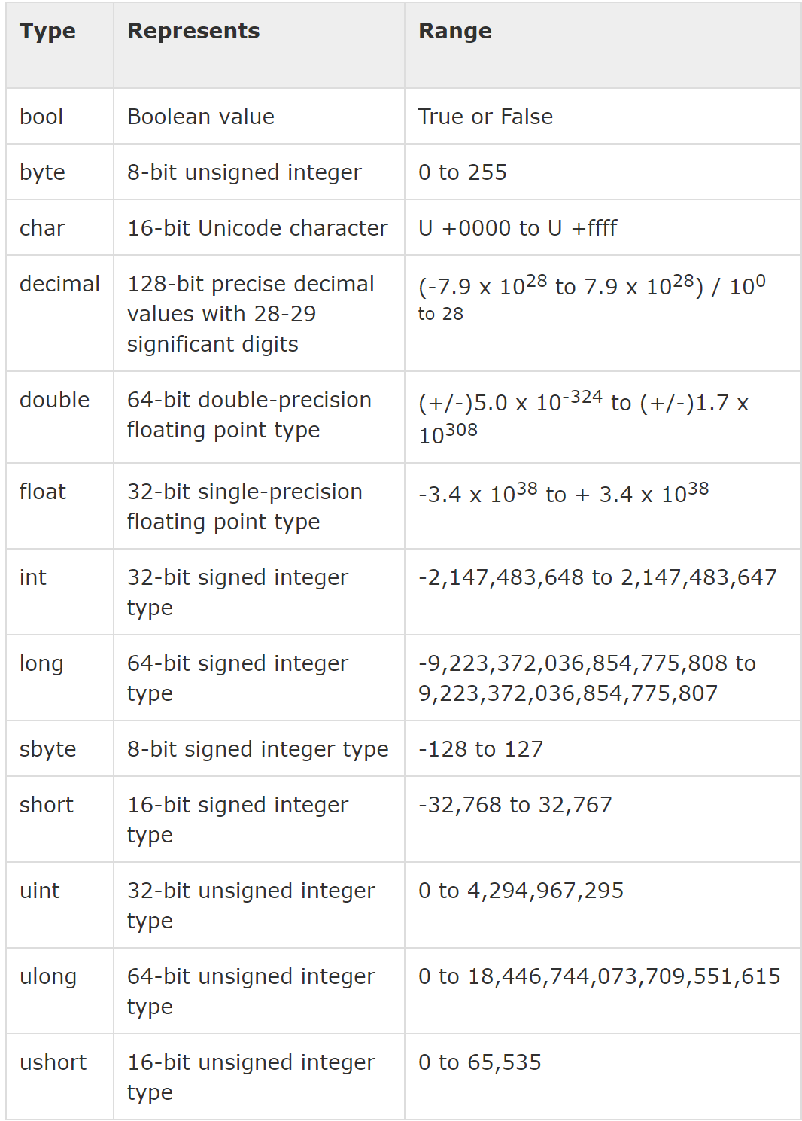
Numeric Types
Numbers in memory
Numbers are Value Types :
C# data type are :
Bool :
Primitive value, can only be True or False
Integers :
Subset of the real numbers. Written without a fraction / decimal. Falls within a set Z = {..., -2, -1, 0, 1, 2, ...}.
Floating point numbers :
Real numbers in computing. Three floating point types : float, double, and decimal
Arithmetic overflow :
A condition that occurs when a calculation produces a result that is outside the range of the chosen datatype.
Notes:
See Exception when out of range

Slide 14
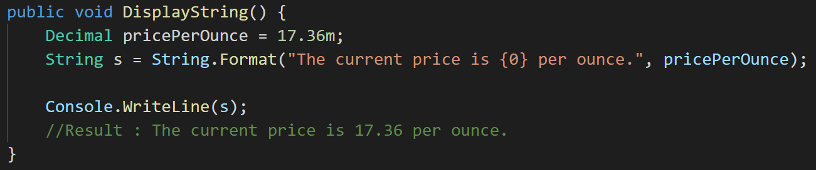
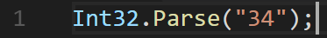
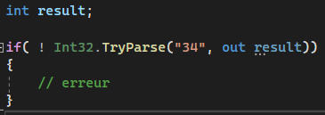
Numeric Types
Display and parsing Numbers
Display :
String.Format() then Console.WriteLine()
Convert :
Parse()
Parse() exists for every number type
Ex : String to Int :
Throws an exception if conversion fails
TryParse()
Returns a bool value if conversion fails

Slide 15
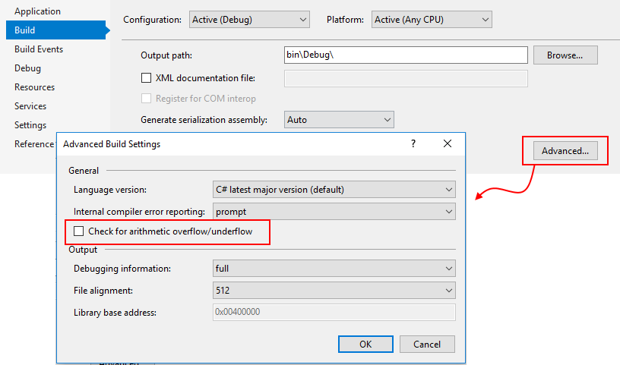
Numeric Types
Checked & Unchecked contexts
Checked
Exception thrown on arithmetic overflow
Unchecked
Exception ignored on arithmetic overflow
Result is truncated
Note : if not specified the context depends on external factors such as compiler options.
Notes:
A tester

Slide 16
Numeric Types
Guidelines
DO | Use the right level of precision regarding Memory
DO | Specify the right number type in literals (1,455 for float or 1,3d for double)

Slide 17
System Types
Text

Slide 18
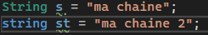
Text
Class System.String or type string
Is a Reference Type
Is immutable (data value inside the String can’t be changed)
Has a Value Type behavior
Stores characters in Unicode 16
Char != Unicode character*
*Even if it’s true 99,999% of the time
Notes:
Unicode character : https://en.wikipedia.org/wiki/List_of_Unicode_characters
var chars = new[]
{
'j',
'\u006A',
'\x006A',
(char)106,
};
Console.WriteLine(string.Join(" ", chars)); // output: j j j j

Slide 19
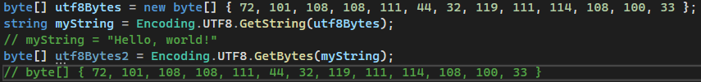
Text
Encoding
Default : DO NOT USE IT ☺
GetBytes() : Conversion String => byte[]
GetChars() : Conversion byte[] => char[]
GetString(): Conversion byte[] => string
When reading/writing files :
Most often can’t be determined from text file
Always specify encoding
Common encodings :
UTF7
UTF8
UTF16 (Little/Big Endians)
UTF32
Code page 1252 (West European Windows)

Slide 20
Text
Guidelines
DO | always use encoding to read and write text

Slide 21
System Types
DateTime

Slide 22
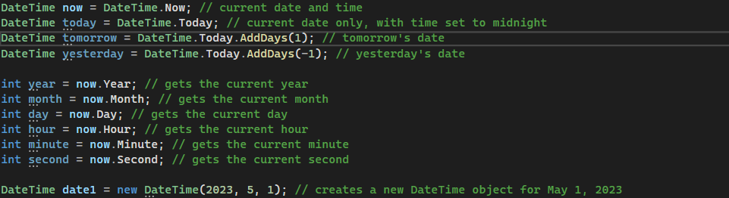
DateTime
What’s that ?
Is a struct
Represents an instant in time, typically expressed as a date and time of day
Has static properties : Now/UtcNow/Today
Has properties : Kind/Date/Year/Month…

Slide 23
DateTime
Guidelines
DO | make sure to always use DateTime.UtcNow when saving data
DO | convert any UTC date to the user’s time zone in the presentation layer (use the ToLongDateString() method for example)
DON’T | use a DateTime value without checking the value of its Kind property first

Slide 24
System Types
Value Types

Slide 25
Value Types
Principles
Derived from System.ValueType
Represent the actual Data, not a reference to it
Value Types such as local variables and method parameters are stored in the Stack but maybe also on the heap depending on context
Memory Allocation if fixed in advance
Don’t require Garbage collection unless they are boxed (in the heap)
Warning: when passing parameters or assigning to variable, all data is copied (imagine passing an array by value!)
Value Type may be a:
Struct
Enum
Numbers
Char

Slide 26
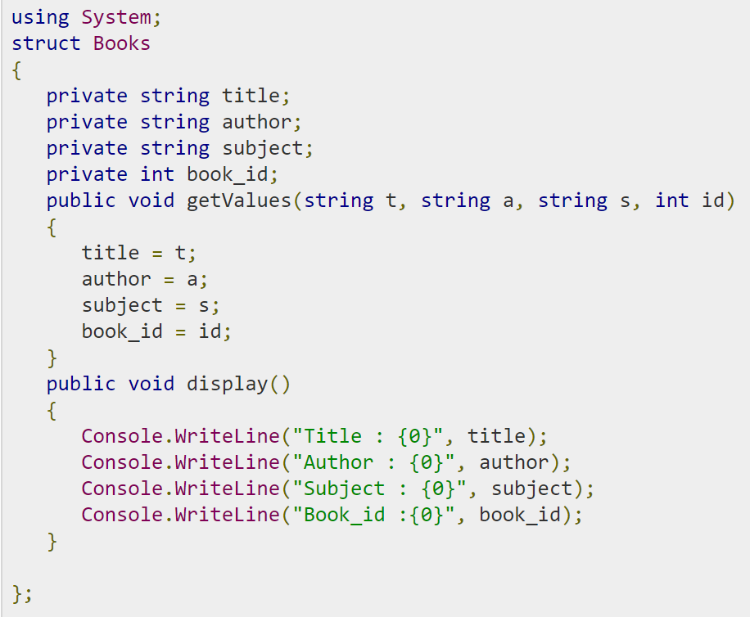
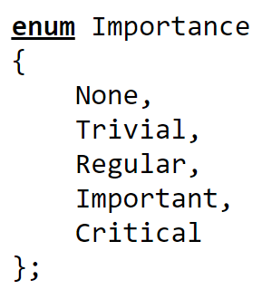
Value Types
Examples
An enum enable to work with a set of valid values or may represent numbers with names
Enums are backed on a number type (by default int, but one can specify any integral type)
*
A struct has fields, properties and methods like a class but no inheritance, no finalizers, no abstraction
* Those are C# language types, mapping to equivalent CTS types (e.g. int = System.Int32, etc…)

Slide 27
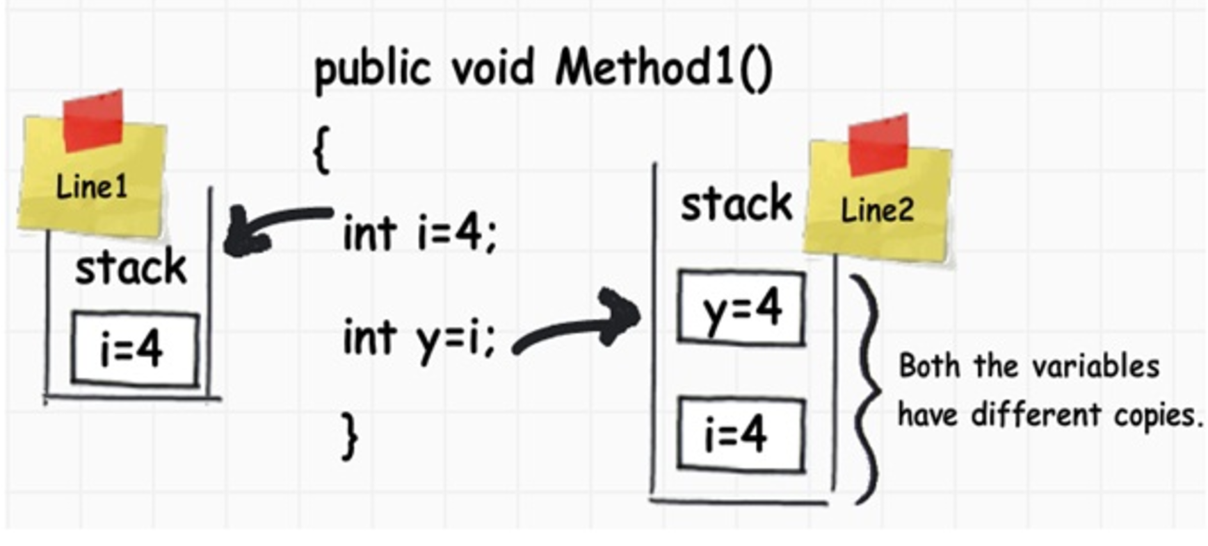
Value Types
behavior
When we assign a value type value to another value type value, it creates a completely fresh copy

Slide 28
System Types
Reference Types

Slide 29
Reference Types
Derived from System.Object
A Reference type stores the address of where the value is stored
Reference type objects are always created on the Heap
Memory Allocation is dynamic
Always require a Garbage collection to be removed from memory
A Reference Type may be:
Class
Delegate
Arrays
String
Dynamic
Record
Notes:
Cf. Microsoft Doc → Actions: Action<T> Delegate (System) | Microsoft Learn
Func : Func<T,TResult> Delegate (System) | Microsoft Learn
Un delegate est un type référence qui peut être utilisé pour encapsuler une méthode anonyme ou nommée. Les délégués sont comparables aux pointeurs fonction en C++, mais ils offrent l’avantage d’être sûrs et de type sécurisé.
Une interface peut être membre d’un espace de noms ou d’une classe, et peut contenir les signatures des membres suivants :
Méthodes
Propriétés
Indexeurs
Événements
Le type dynamic permet aux opérations dans lesquelles il se produit de contourner la vérification de type au moment de la compilation. Au lieu de cela, ces opérations sont résolues au moment de l’exécution

Slide 30
Conditional logic

Slide 31
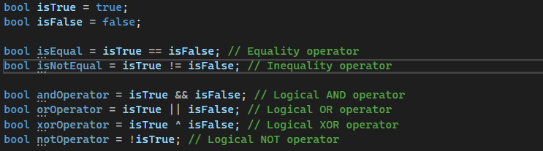
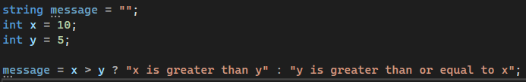
Conditional logic
What’s that ?
« bool » / System.Boolean (Bool is not an int (for C/C++ users))
2 values: true/false
Operators :
==
!= (classics)
And: x && y
Or: x | | y
Xor x ^ y
Not: !x (specific)
The right part is evaluated only if necessary
Conditional operator: t ? x : y
Flow control: if - else if - else, switch
Loops: for, while, do-until, for each

Slide 32
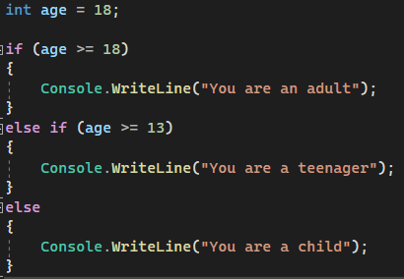
Conditional logic
Control flow – if then else
Notes:
In this example, the first if statement checks if age is greater than or equal to 18. If the condition is true, the code block inside the if statement will be executed (Console.WriteLine("You are an adult");).
If the condition is false, the second if statement checks if age is greater than or equal to 13. If the condition is true, the code block inside the second if statement will be executed (Console.WriteLine("You are a teenager");).
If both conditions are false, the code block inside the else statement will be executed (Console.WriteLine("You are a child");).
Note that the order of the if-else statements matters. The first condition that is true will cause its corresponding code block to be executed, and the remaining conditions will be skipped.

Slide 33
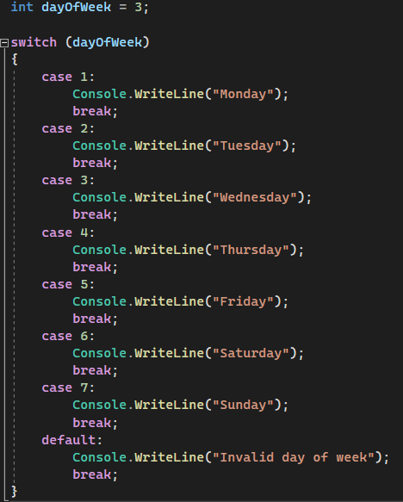
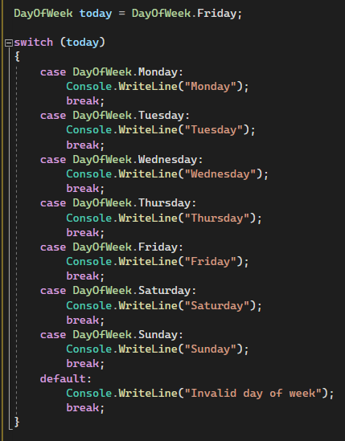
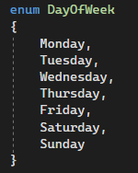
Conditional logic
Control Flow : switch
Notes:
In this example, the expression being evaluated is the variable dayOfWeek. The case statements specify the values that the expression might have, and the code block following each case statement is executed if the expression matches the specified value.
If none of the case statements match the value of the expression, the code block following the default statement is executed.
In this case, since dayOfWeek is equal to 3, the output of this code will be "Wednesday".
Note that each case statement must be followed by a break statement to prevent the code from falling through to the next case. If you want to execute the code for multiple case statements, you can use the goto case statement.

Slide 34
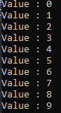
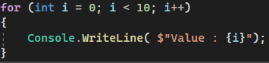
Conditional logic
Control Flow – for
Notes:
In this example, the loop will iterate 10 times because the condition i < 10 will be true for the values of i from 0 to 9. The output of this code will be the numbers 0 to 9.

Slide 35
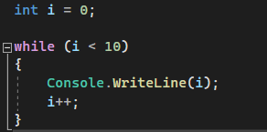
Conditional logic
Control Flow : while
Notes:
In this example, the loop will iterate 10 times because the condition i < 10 will be true for the values of i from 0 to 9. The output of this code will be the numbers 0 to 9.

Slide 36
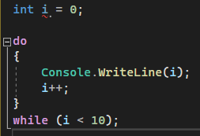
Conditional logic
Control Flow – do-while
Notes:
In this example, the loop will iterate 10 times because the condition i < 10 will be true for the values of i from 0 to 9. The output of this code will be the numbers 0 to 9.

Slide 37
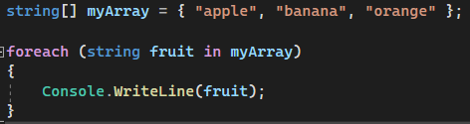
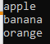
Conditional logic
Control Flow - foreach
Notes:
In this example, the loop will iterate over each element in the myArray array, and the fruit variable will represent each string in turn. The loop body simply prints out the value of the fruit variable.
The foreach loop can be used with any collection that implements the IEnumerable interface, which includes arrays, lists, and many other collection types in C#.

Slide 38
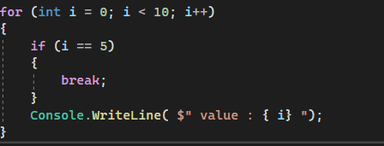
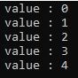
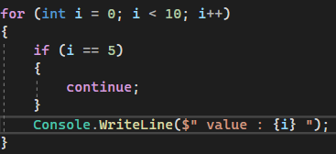
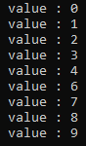
Conditional logic
Control Flow – Break & Continue
Notes:
In this example, the for loop will iterate from 0 to 9, but when i equals 5, the break statement will be executed and the loop will immediately terminate.
In this example, when i equals 5, the continue statement will be executed and the loop will immediately move on to the next iteration, skipping over the code that comes after it.

Slide 39
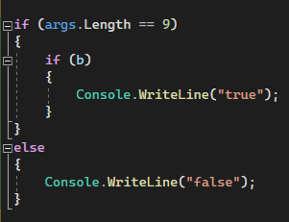
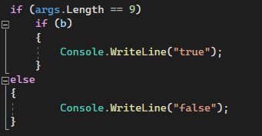
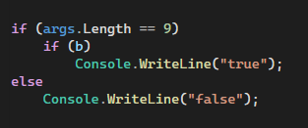
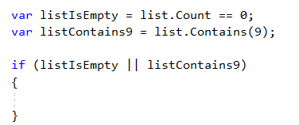
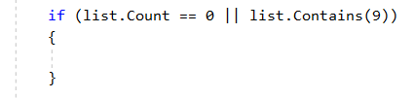
Conditional logic
Guidelines
DO | avoid method call in boolean expression
DO | always use curly braces with if-else operator
DON’T | use complex boolean expression, try to decompose
Notes:
Clean code
bool b = true;
if (args.Length == 9)
if (b)
{
Console.WriteLine("true");
}
else
{
Console.WriteLine("false");
}
if (args.Length == 9)
if (b)
Console.WriteLine("true");
else
Console.WriteLine("false");
if (args.Length == 9)
{
if (b)
{
Console.WriteLine("true");
}
}
else
{
Console.WriteLine("false");
}

Slide 40
Visibility

Slide 41
Visibility
There are five visibility modifiers in C#
public: A public type or member can be accessed from anywhere, including from other assemblies. This is the most permissive visibility modifier.
private: A private type or member can only be accessed from within the same class or struct. This is the most restrictive visibility modifier.
protected: A protected type or member can be accessed from within the same class or struct, or from a derived class. It cannot be accessed from outside these contexts.
internal: An internal type or member can be accessed from within the same assembly. It cannot be accessed from outside the assembly, even from a derived class.
protected internal: A protected internal type or member can be accessed from within the same assembly or from a derived class, even if the derived class is in a different assembly.

Slide 42
Class

Slide 43
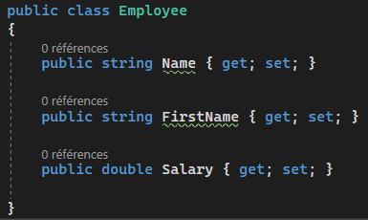
Class
Aka: complex reference type
An object is an instance of a class
Inherits from System.Object
Can only inherit from one class but several interfaces
Can be static
Can have static members (even if the class isn’t static)
Each member can have its own visibility
Member’s accessibility depends also on the class’s accessibility
Must have a single responsibility (SOLID)

Slide 44
Struct

Slide 45
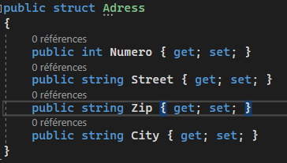
Struct
Aka: Complex value type
Value type
Have members
Fields
Properties
Methods
Assignment means copy
Built-in numerics: structs
Sealed
Can implement interfaces (casting means boxing)
The constructor must initialize all the fields

Slide 46
Nullable types
Nullable types
By default, value type are not nullable (because no reference)
Can be achieved with the generic type Nullable<T> (Chapter 7)
“Nullable<MyStruct>” can be replaced in the code by “MyStruct?”

Slide 47
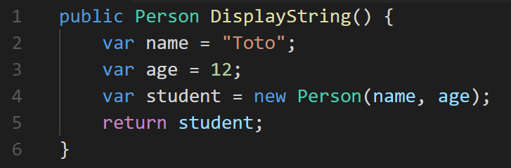
Type Inference
Syntactic sugar
Lets the compiler determine the variable type

Slide 48
Guidelines
DO | Create structs instead of classes if you need « value type like » behavior (copy instead of reference)
DON’T | use reference type inside struct (string is an exception because the string class is immutable)
Notes:
Immutable: data where values can’t be changed
Exercice. Create a Coordinate struct, with methods:

Slide 49
Exception handling

Slide 50
Exception handling
What’s an Exception ?
An exception is an object
System.Exception or a child class
You can write your own exception class
Before creating an exception class, check for the existing ones
Keywords:
throw
try-catch-finally
Main properties:
Message
Stacktrace
InnerException

Slide 51
Exception handling
Exceptions must be used for
For exceptional event
For unexpected event
Exceptions must never be used for
For returning an expected result
As a control flow mechanism

Slide 52
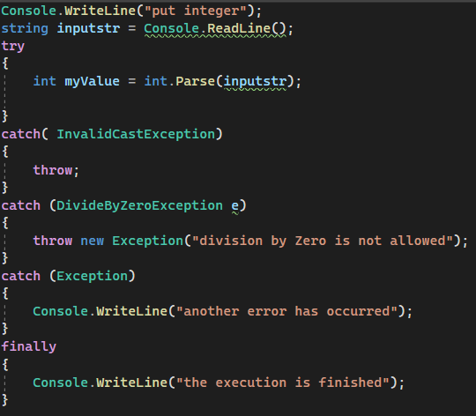
Patterns
Re throws the same exception
Throws a new one with a reference of the original
Just handle it, return to normal
Always executed
Notes:
Recommandation:
- use exception “shielding” between tiers (do not say to much of your internal implementation). Ensure that stack trace won’t be display to the end-user.
- order your Exception from the more specific to the less specific (Exception) from top to bottom.
- handle and rethrow original exception in a single tier (easier to debug).
- add log mechanism in addition to Exception handling. It will help to manage production issues more easily and avoid the “black-box” behaviour
throw; preserves the original stack trace of the exception, which is stored in the Exception.StackTrace property. Opposite to that, throw e; updates the StackTrace property of e.

Slide 53
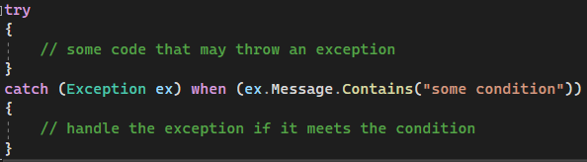
Exception filters
Add condition to a catch clause
Better visibility if the content on the exception can influence the code (throw or not throw)
Notes:
Exception filters in C# provide a way to catch and handle specific exceptions based on certain conditions. They allow you to specify a Boolean expression that is evaluated when an exception is thrown, and if the expression is true, the catch block is executed.

Slide 54

DEMO
Handling Exceptions in a C# Project
Implementing custom Exceptions
Notes:
Show how the exception flow from the demo program ExceptionHandling, compare the differents way to handle exception: throw, throw ex, new exception
Look at MyException pattern (constructors)

Slide 55
Encoding
Defines :
Storage
Memory
Disk
On screen display
Common encodings :
UTF7
UTF8
UTF16 (Little/Big Endians)
UTF32
Code page 1252 (West European Windows)

Slide 56
System.Text.Encoding
Default : DO NOT USE IT ☺
GetBytes() : Conversion String => byte[]
GetChars() : Conversion byte[] => char[]
GetString(): Conversion byte[] => string
When reading/writing files :
Most often can’t be determined from text file
Always specify encoding

Slide 57
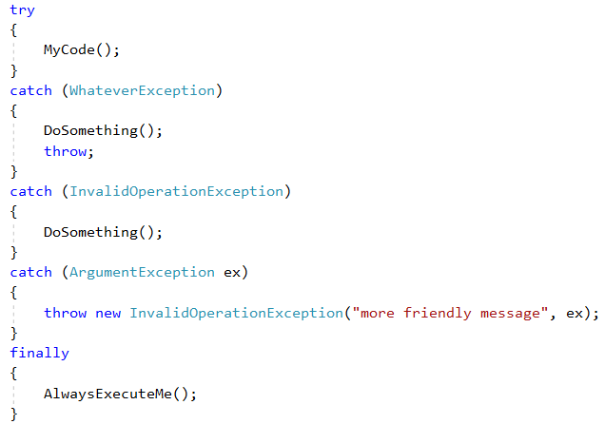
Patterns
Re throws the same exception
Just handle it, return to normal
Throws a new one with a reference of the original
Always executed
Notes:
Recommandtion:
- use exception “shielding” between tiers (do not say to much of your internal implementation)
- handle and rethrow original exception in a single tier (easier to debug).

